Slide 1
DESIGN AND IMPLEMENTATION OF QUAD NOTCH UWB ANTENNA
GUIDED BY
Mr.S.KULASEKARAPANDIAN
TEAM MEMBERS
Ms.M.SHEEREEN NISMA(810020106082)
Ms.M.VAISHALI(810020106091)
Mr.Y.GOWTHAM KUMAR(810020106303)
1

Slide 2
OBJECTIVE & BASE PAPER
Our objective is to design a quad notch ultra wide band antenna.
TITLE OF THE BASE PAPER:
Quad notch UWB antenna using combination of slots and split-ring resonator.(2019)
NAME OF THE AUTHORS:
Mrinmoy Chakraborty
Srikanta pal
Neela Chattoraj
2

Slide 3
INTRODUCTION
UWB DEFINITION:
Ultra-wideband(uwb,ultrawideband,ultra-wideband and ultra-wide)is a radio technology that can use a very low energy level for short-range,high-bandwidth communications over a large portion of the radio spectrum.
UWB antennas enable the effective use of the bandwidth in high data rates. . Antennas with wide bandwidth. Range of UWB -3. 1 to 10.6GHz
3

Slide 4
LITERATURE SURVEY
1. “First report and order ,Revision of part 15 of the commission’s rule regarding ultra wideband transmission system FCC 02-48” .Federal communications Commission;2002.
2. “Branch Sr Band notched elliptical slot UWB microstrip antenna with elliptical stub filled by the H shaped slot” .J Electromagn Waves Appl.2008;2:1993-2002.
3.Kim KH,Park SO. “Analysis of the small band rejected antenna with the parasitic strip for UWB” .IEE Trans Antennas Propag.2006;54(6):1688-1692.
4.Thomas KG Sreenivasan M . “A simple ultrawideband planar rectangular printed antenna with band dispensation” .IEEE Trans Antenna Propag .2010;58(1):27-34.
5.Xu KD ,Zhang HY ,Spiegel RJ,Fan Y ,Joines WT ,Liu QH. “Design of a stub loaded ring resonator slot for antenna applications”. IEE Trans Antennas Propag.2015;63(2):517-524.
6.Manohar M Kshetrimayum RS ,Gogoi AK . “A compact dual band notched circular ring printed monopole antenna for super wideband applications”.Radio-Eng.2017;26(1):64-70.
4

Slide 5
Contd…
7.Peddakrishna s,Khan T. “Design of UWB monopole antenna with dual notched band characteristics by using p shaped slot and EBG resonator .” AEU Int J Electron Commun.2018;96:107-112.
8.Li,Y,Li W,Mitra R. “Miniaturized CPW fed UWB Antenna with dual frequency rejection bands using stepped impedance stub and arc shaped parasitic element.”Microw Opt Technol Lett 2014.
9.Vendik IB,Rusakov A,Kanjanasit K,Hong J,Filonov D. “Ultra wide band planar antenna with single,dual and triple band notched characteristic based on electric ring resonator”. IEE Trans Antennas Wirel Propag lett.2017;16:1597-1600.
10.Yadav et al. “SRR and S Shaped slot loaded triple band notched UWB antenna”. AEU Int J Electron commun 2017;79:192-198.
11.Sidiqui JY Saha C ,Antar Y ,Yahia MM. “Compact SRR;loaded UWB Circular monopole antenna with frequency notch characteristics.” IEE Trans Antennas Propag.2014;62(8):4015-4020.
12.Marques R. Martin F,Sorolla M. “Metamaterials with Negative parameters: Theory,Design and Microwave Applications”. New Jersey:John Wiley&Sons;2011.
13.Saha C,Sidiqui J Antar Y. “Mulifunctional Ultra wideband antenna:Trends,techniques and application.”Boca Raton:CRC Press;2019.
14.Mrinmoy Chakraborty,Sriknta Pal,Neelaj Chattoraj “Quad notch uwb antenna using combination of split ring resonator and slots.”2019.
5

Slide 6
EXISTING WORK
The existing work contains the design of an UWB antenna with four notches.
The notch characteristics is introduced by
U shaped slot in the patch
U shaped slot in ground 1
U shaped slot in ground 2
A split ring resonator at the back side of the antenna structure.
The stopbands are:
3.3 to 3.7GHz-WiMAX
5.15 to 5.35GHz-WLAN1
5.725 to 5.825GHz-WLAN2
7.25 to 7.75GHz-X BAND
6

Slide 7
PROPOSED WORK
The proposed work contains the design of an UWB antenna with four notches.
The notch characteristics is introduced by
A U shaped slit in the patch
A rectangular slot in the patch
A split ring resonator and
A mushroom structure at the back side of the antenna structure.
The stop bands are:
3.7 to 4.2GHz-C band.
5.15 to 5.35GHz-WLAN1 .
5.725 to 5.825GHz-WLAN2 .
8.025 to 8.4GHz-X band.
7

Slide 8
METRICS TO BE MEASURED
QUALITATIVE
QUANTITATIVE
Accuracy of notch
Robustness
Accessibility
Compatibility
s11 parameter
s12 parameter
VSWR
Input Impedance
Efficiency
Size of antenna
Radiation pattern
Bandwidth
Gain (in dBs)
8

Slide 9
EXPECTED OUTCOME
An antenna of ultra wideband with notch characteristics
An UWB antenna with four notches i.e with four stopbands at the required frequency range .
The antenna should radiate in the ultra wide band except in those notch frequency ranges.
NOTCH :
A"notch" refers to a specific frequency range within the overall UWB spectrum where the antenna exhibits reduced or suppressed performance. Essentially, a notch in the antenna's frequency response means that the antenna intentionally avoids or attenuates signals within that particular frequency range.
STOPBANDS:
3.7 to 4.2GHz-C band.
5.15 to 5.35 GHz-WLAN1
5.725 to 5.825 GHz –WLAN2
8.025 to 8.4 GHz-X BAND
9

Slide 10
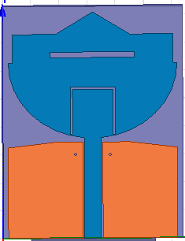
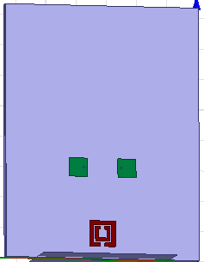
BLOCK DIAGRAM
FRONT VIEW
BACK VIEW
10

Slide 11
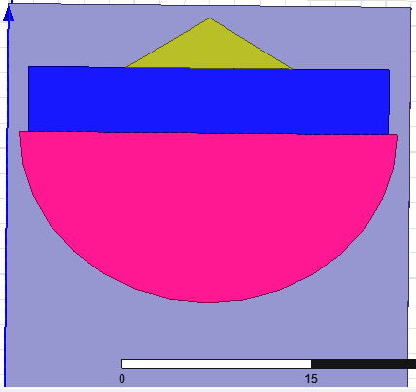
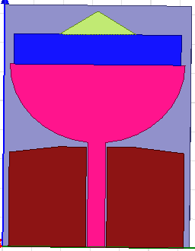
BASIC STRUCTURE
PATCH PATCH WITH CPW
SHAPES USED TO FORM PATCH :
Rectangle
Triangle
Half ellipse
11

Slide 12
DIMENSIONS OF BASIC STRUCTURES (in mm)
DIMENSIONS OF PATCH:
HALF ELLIPSE:
MAJOR RADIUS→15
TRIANGLE:
HEIGHT→6.6
BASE LENGTH→13.2
RECTANGLE:
LENGTH→5.17
BREADTH→28.62
DIMENSIONS OF COPLANAR WAVEGUIDE:
GROUND:
LENGTH→17.19
BREADTH→13.2
STRIP:
LENGTH→17.96
BREADTH→3
12

Slide 13
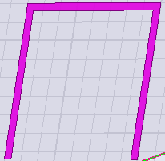
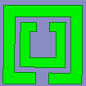
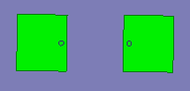
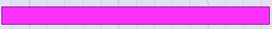
NOTCH STRUCTURES
FRONT SIDE
BACK SIDE
U SHAPED SLIT SPLIT RING RESONATOR
RECTANGULAR SLOT MUSHROOM STRUCTURE
13

Slide 14
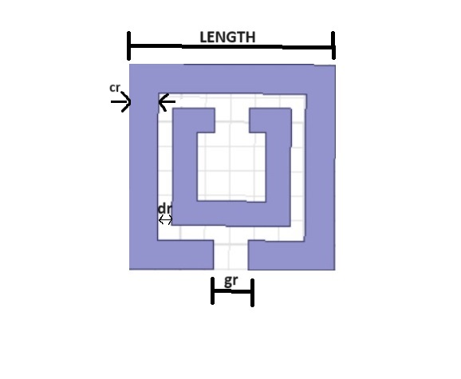
DIMENSIONS OF NOTCH STRUCTURES (in mm)
3.SPLIT RING RESONATOR:
LENGTH OF THE SQUARE→4.2
Cr→0.6
dr→0.3
S→0.5
gr→0.7
4.MUSHROOM STRUCTURE:
LENGTH OF THE SQUARE→4.5
RADIUS OF CYLINDER→0.2
HEIGHT OF CYLINDER→1.6
1.U SHAPED SLIT:
LENGTH→8.45
BREADTH→7.99
WIDTH→0.4
2.RECTANGULAR SLOT :
LENGTH→15
BREADTH→1
14

Slide 15

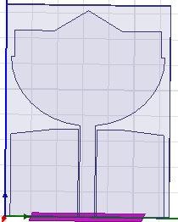
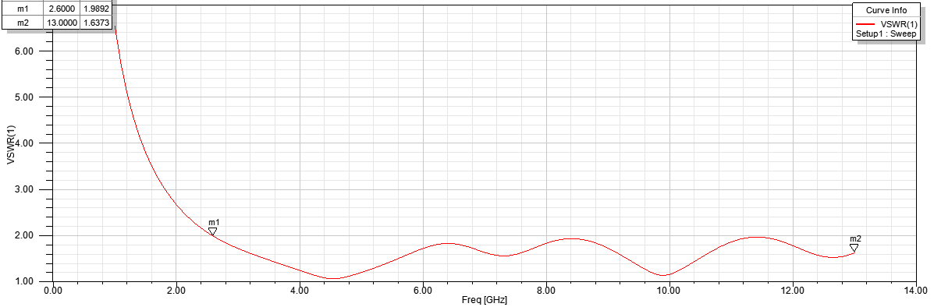
SUB-BLOCKS BASIC UWB ANTENNA WITH SIMULATED RESULT
Radiating range→2.6 to 13GHZ
15

Slide 16
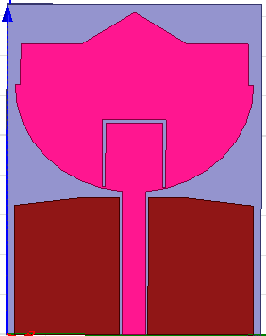
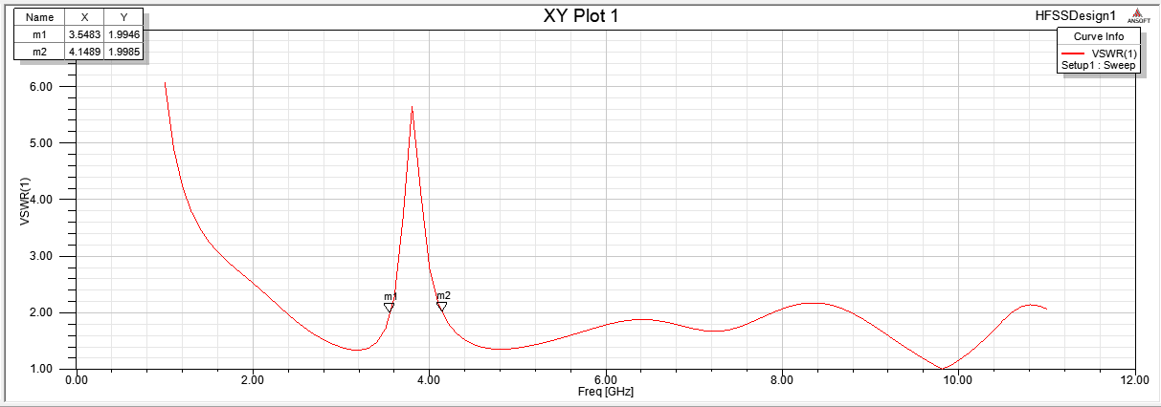
SIMULATED RESULTS OF NOTCH STRUCTURES U-SHAPED SLIT WITH SIMULATED RESULT
NOTCH BAND C BAND→3.7 TO 4.2GHZ
16

Slide 17
RESONANT FREQUENCY fr OF THE U-SHAPED SLIT
fr = (c/2(L1+L2+W)) (√2/€r+1)
where ,
fr=resonant frequency
c = 3x10^8 m/s
€r=4.4
L1=length of one arm of the slit
L2=length of another arm of the slit
W=Width of the slit
17

Slide 18
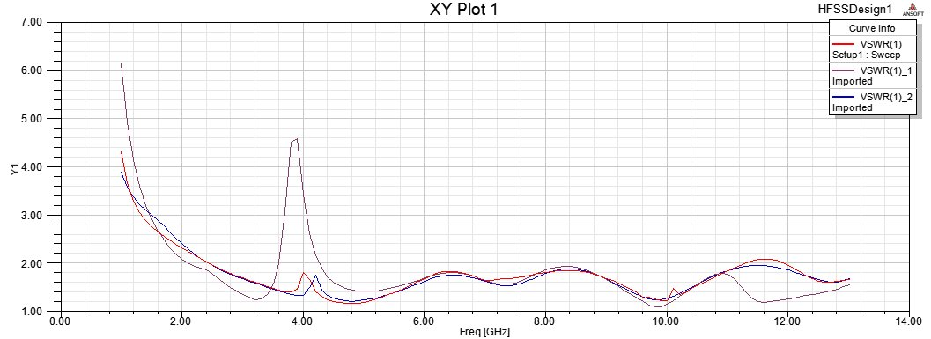
RESULTS OF U- SHAPED SLIT FOR VARIOUS DIMENSIONS
(in mm)
->Slit Width=0.3
->Slit Width=0.4
->Slit Width=0.5
18

Slide 19
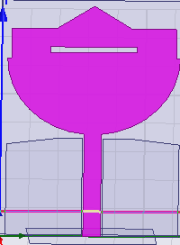
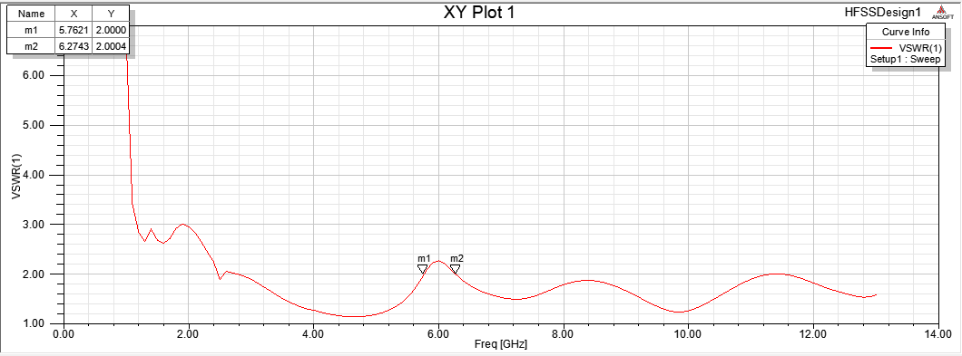
RECTANGULAR SLOT WITH SIMULATED RESULT
NOTCH BANDWLAN 2→ 5.725 TO 5.825
19

Slide 20
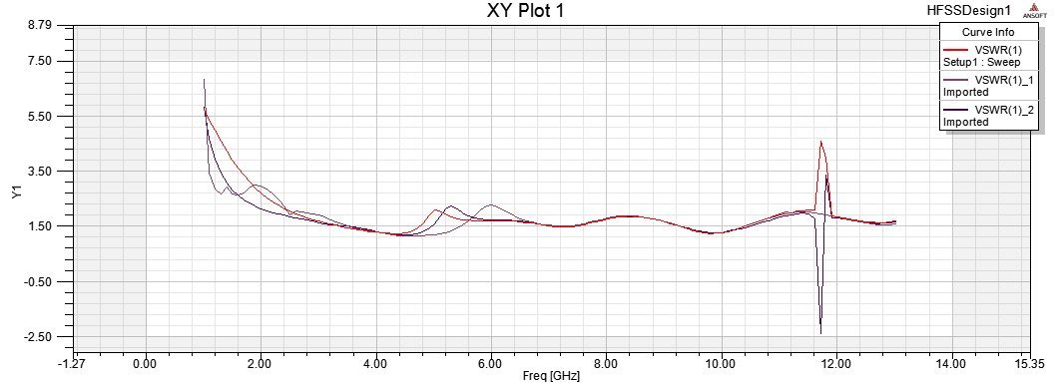
RESULTS OF RECTANGULAR SLOT FOR VARIOUS DIMENSIONS
(in mm)
->Rectangle length=14
->Rectangle length=15
->Rectangle Length=17
20

Slide 21
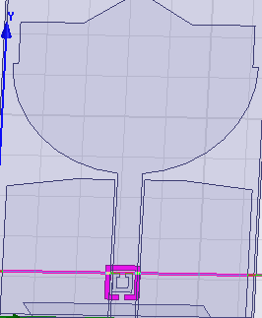
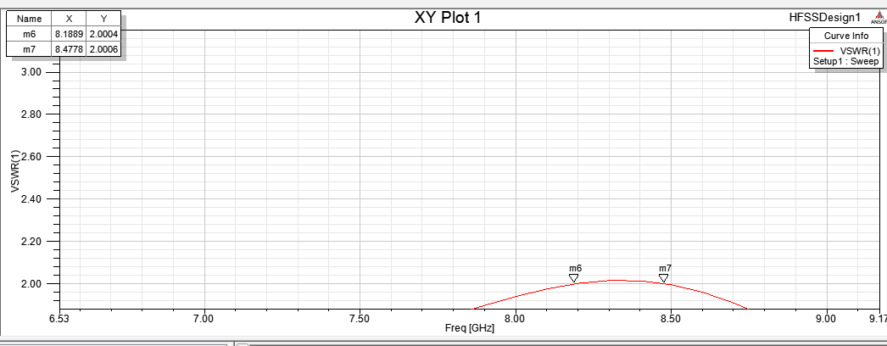
SPLIT RING RESONATOR WITH SIMULATED RESULT
NOTCH BANDX BAND→8.025 TO 8.4GHZ
21

Slide 22
RESONANCE FREQUENCY fo OF THE SPLIT RING RESONATOR
fo=(1/2π)(√(1/LtCe))
where
Ce=(2aavg-gr/2)Cpul+(ε0ctm/2gr)
Cpul=√εe/CoZo
Lt = 0.0002l (2.303log104l/Cr-γ)μH
l= 8ae −gr
aavg=ae-cr-dr/2
fo=Resonance frequency .
Ce=Total equivalent capacitance of the structure .
Lt=Total equivalent inductance .
22

Slide 23
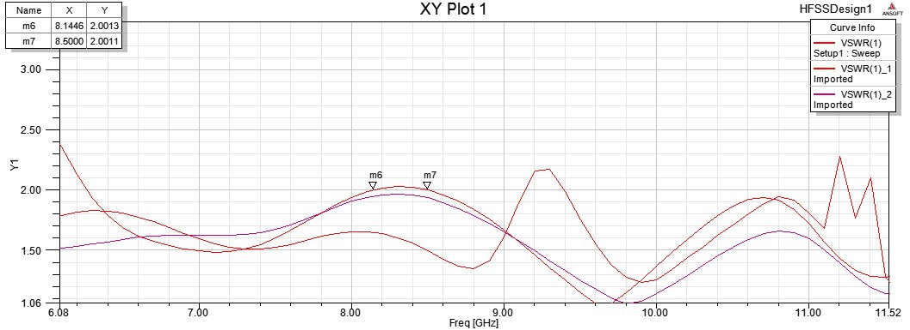
RESULTS OF SPLIT RING RESONATOR FOR VARIOUS DIMENSIONS
(in mm)
->Square size=4
->Square size=4.2
->Square Size=5.2
23

Slide 24
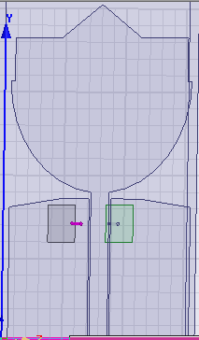

MUSHROOM STRUCTURE WITH SIMULATED RESULT
NOTCH BANDWLAN 1→5.15 TO 5.35GHZ
24

Slide 25
RESONANT FREQUENCY OF THE MUSHROOM STRUCTURE
fr=1/2π√(L(Co+C1))
Co=(Weε0(1+εeff)/π )(cosh-1)((We1+g)/g)
g=d1+(s1+s2)/2
εeff=(εr+1/2)+(εr-1/2)(1+1 2 h/We1)-0.5
L=μoh
C1=(ε0εeffWe1^2/2)
where,
fr=resonant frequency
L= inductance
Co=coupling capacitance between mushroom structure and feedline
C1=capacitance due to voltage gradients between patch and ground plane.
25

Slide 26
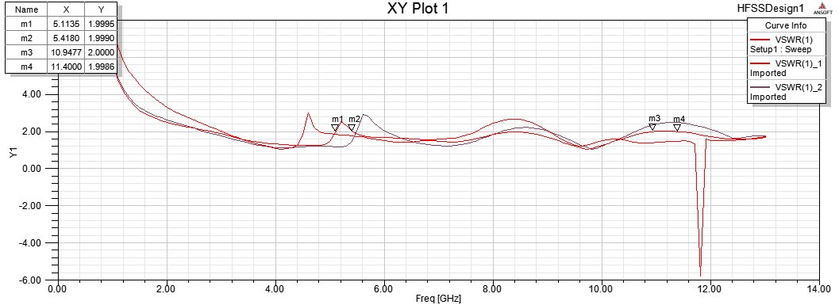
RESULTS OF MUSHROOM STRUCTURE FOR VARIOUS DIMENSIONS
(in mm)
->Square Size=3
->Square size=4.5
->Square Size=5
26

Slide 27
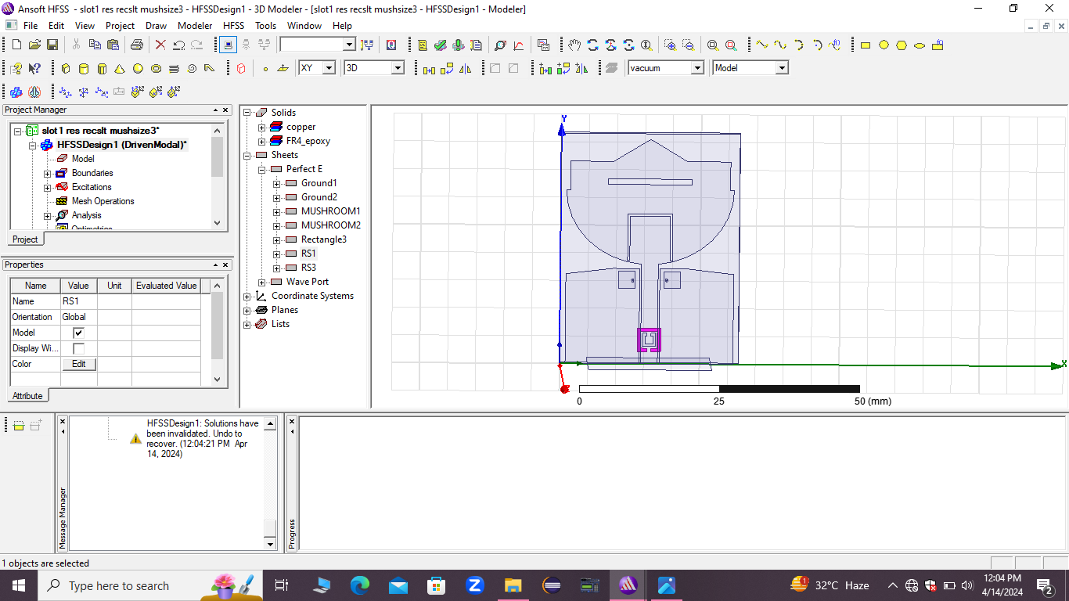
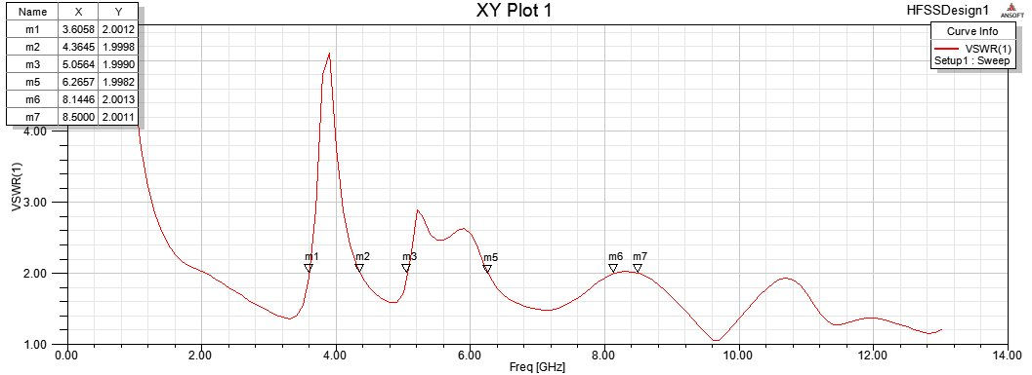
QUAD NOTCH UWB ANTENNA WITH SIMULATED RESULT
27

Slide 28
TOOL
HFSS 13.0 SOFTWARE:
28

Slide 29
REFERENCE
1.First report and order ,Revision of part 15 of the commission’s rule regarding ultra wideband transmission system FCC 02-48 .Federal communications Commission;2002.
2.Branch Sr Band notched elliptical slot UWB microstrip antenna with elliptical stub filled by the H shaped slot .J Electromagn Waves Appl.2008;2:1993-2002.
3.Kim KH,Park SO.Analysis of the small band rejected antenna with the parasitic strip for UWB .IEE Trans Antennas Propag.2006;54(6):1688-1692.
4.Thomas KG Sreenivasan M . A simple ultrawideband planar rectangular printed antenna with band dispensation .IEEE Trans Antenna Propag .2010;58(1):27-34.
5.Xu KD ,Zhang HY ,Spiegel RJ,Fan Y ,Joines WT ,Liu QH.Design of a stub loaded ring resonator slot for antenna applications.
6.Manohar M Kshetrimayum RS ,Gogoi AK .A compact dual band notched circular ring printed monopole antenna for super wideband applications.Radio-Eng.2017;26(1):64-70.
29

Slide 30
THANK YOU !!
30

